Slide 1
Spotify Chart Topper Projecting Tool
Brannon Dugick-April 25 2024

Slide 2
Use Case and Objectives
Use Case: Create a prediction tool that can determine what songs will be popular on spotify.
Objectives:
Determine most performant Feature set | Data Set out of the box has 23 predictors
Determine Target | Target is not defined. Need to determine best target.
Achieve Lowest RMSE | We will use several machine models and need to glean which is the most performant.

Slide 3
Data challenges
Objects Dtype
Lagging Indicator/ Outcome Variable
Needed to convert all feature from object to correct type
Weeks at top of chart was dropped because it is essentially what I am trying to predict Feature follows the event I am trying to predict
Empty Strings
Majority of Features had some NaN or NaT values
Encoding
Dates > Ordinal Encoding Artist > Frequency Encoding

Slide 4
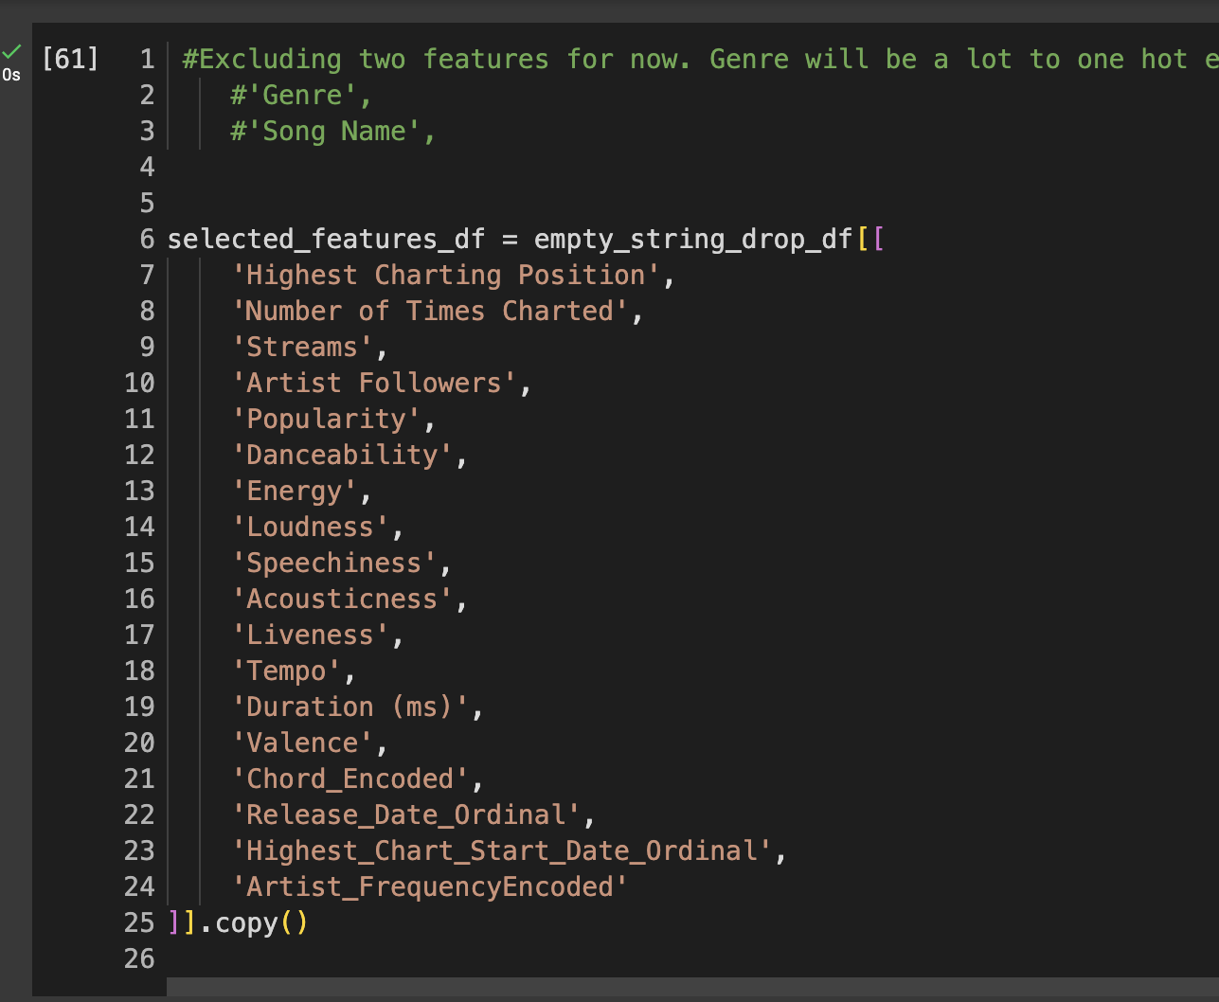
Feature Selection
Weeks Top Chart
Outcome variable
Genre
Value counts: to many variations
Index
Auto Incrementing Key

Slide 5
Models
01
02
Decisions Trees
XG BOOOOST
Pro- Little data wrangling Numerical and Categorical
Con- Overfitting
Pro-Typically most performant, handles null, regulation to prevent overfitting
Con- ironically overfitting if not property tuned
04
Random Forest
Pro- Reduce Overfitting by Avg Multiple trees, Feature importance Scores
Con- Slow due to ensemble of trees, Interpreting multiple trees

Slide 6
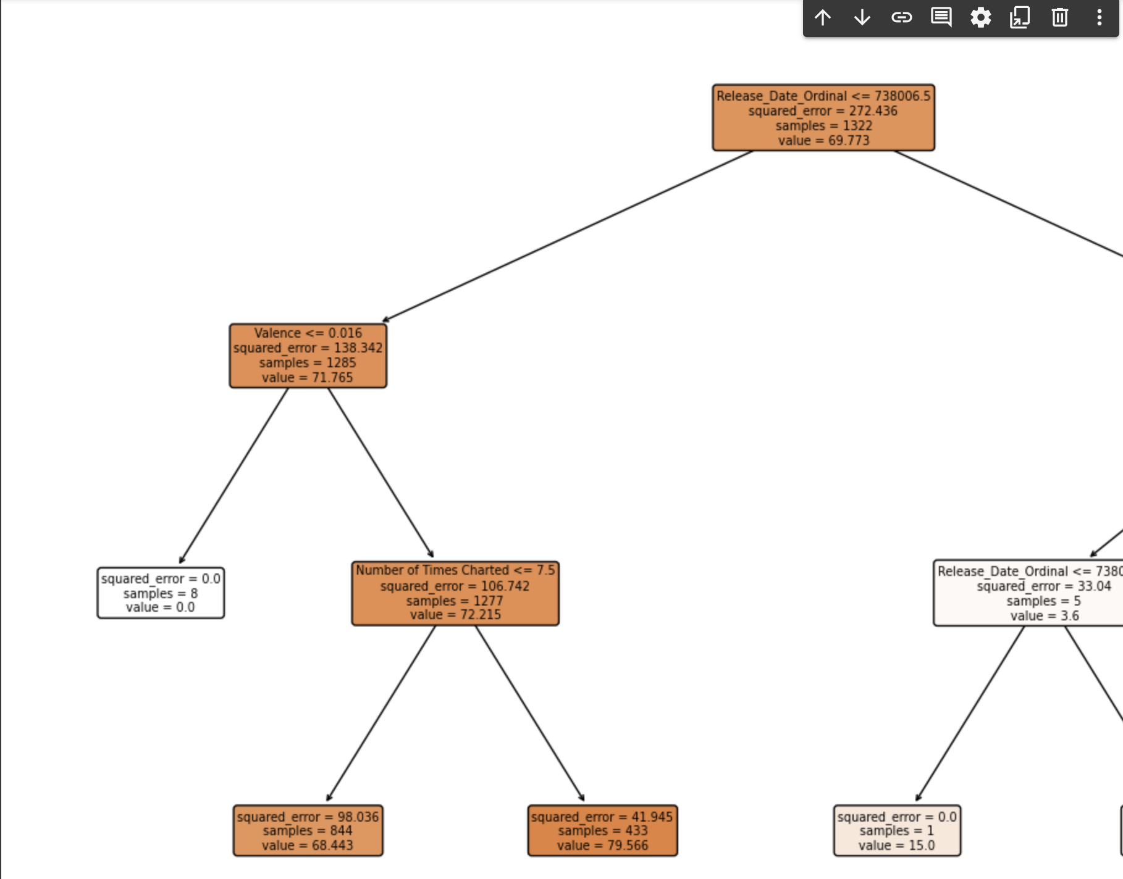
Decision Tree- 9.09

Slide 7
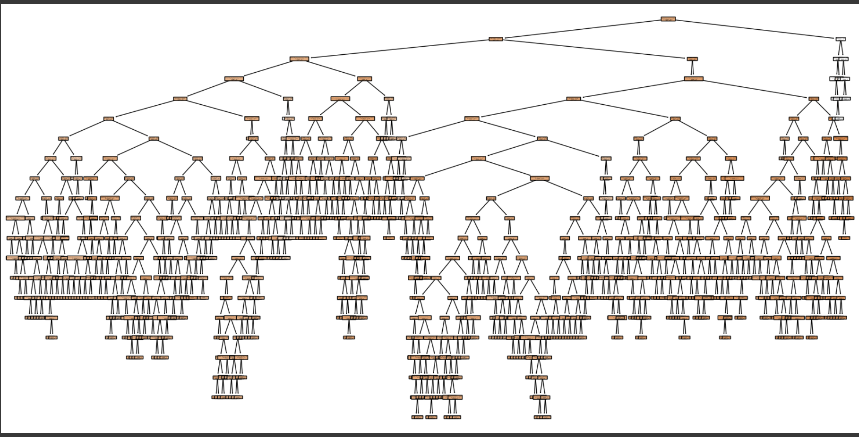
Random Forest- 5.12

Slide 8
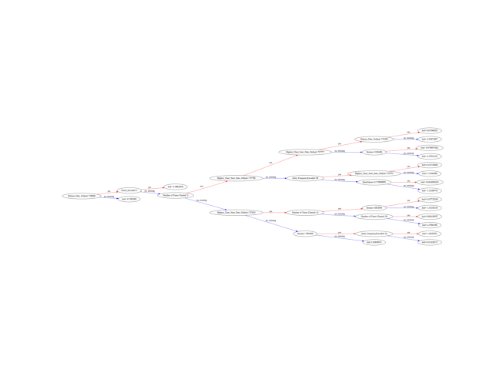
XGBoost - 5.09 > 4.83

Slide 9
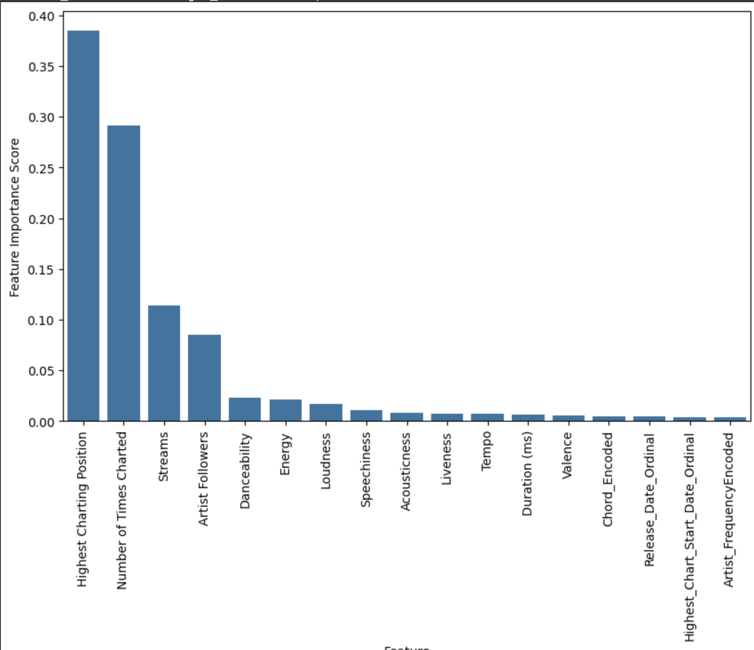
Continued

Slide 10

Again with narrow feature set
XGBoost
9.43
9.02
Random Forest

Slide 11

Again with Hyper Param Auto Tuning
XGBoost
9.23

Slide 12
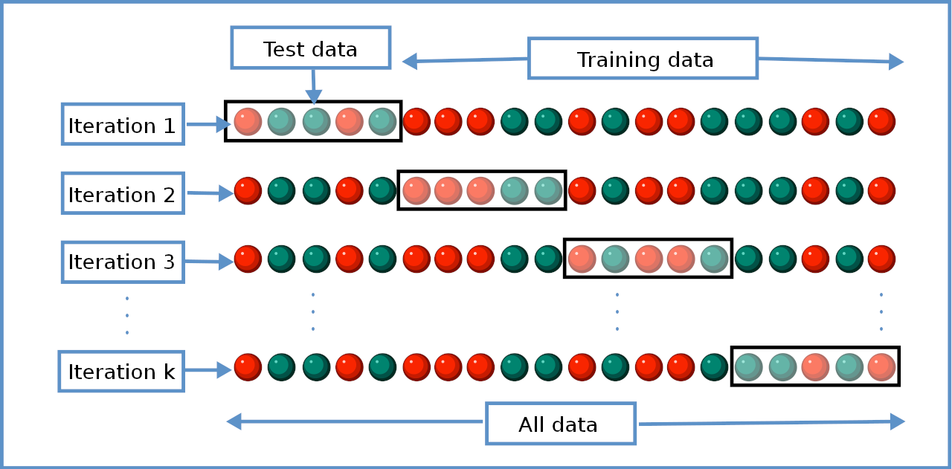
Cross Validate best Model with K-Means

Slide 13
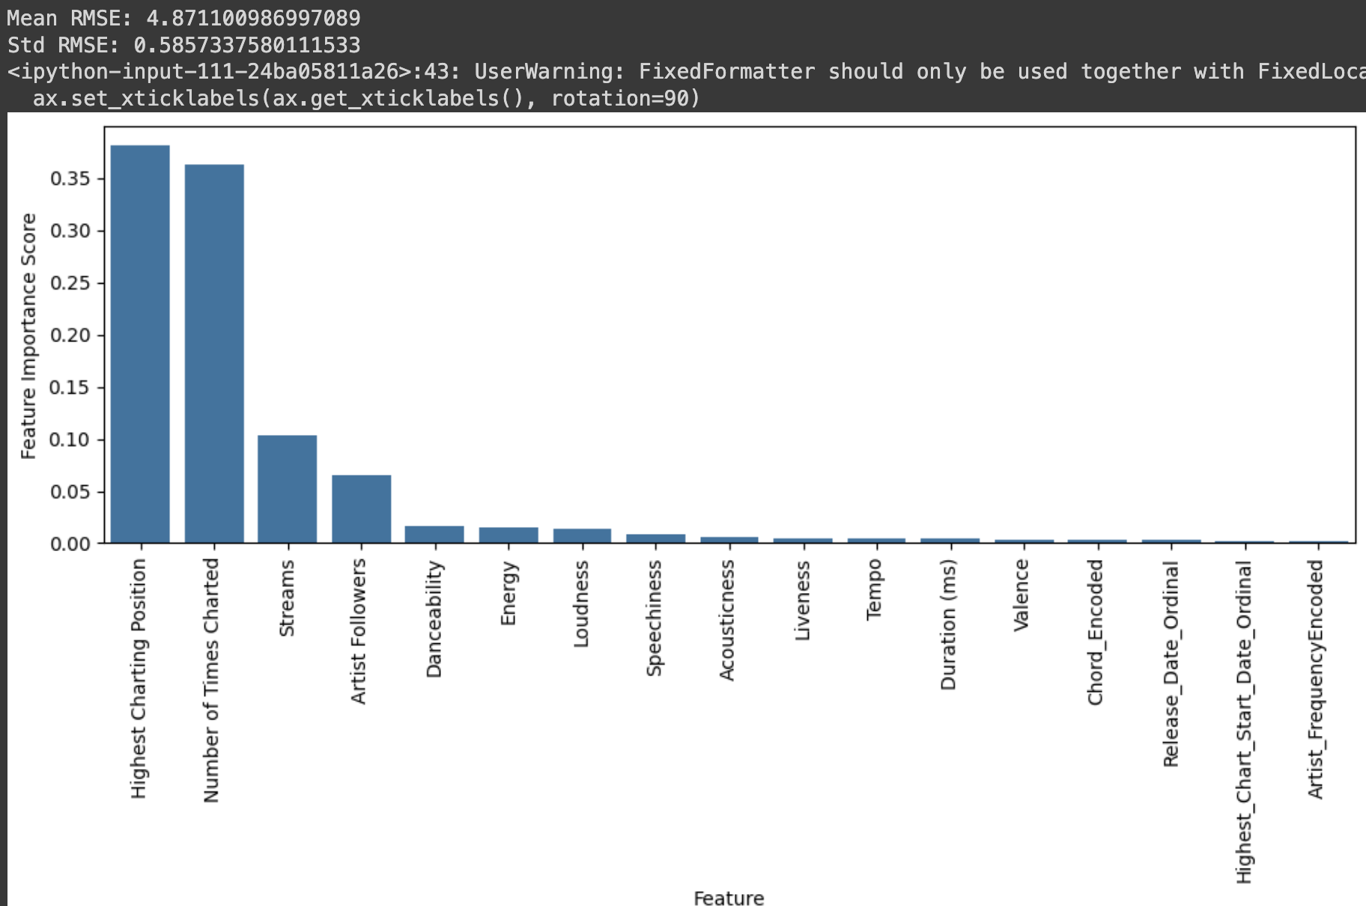
Thanks!

Slide 14
Resources
Data Source
Gradient abstract wireframe background

